Slide 1
Hotel Management System
UML Class Diagram

Slide 2
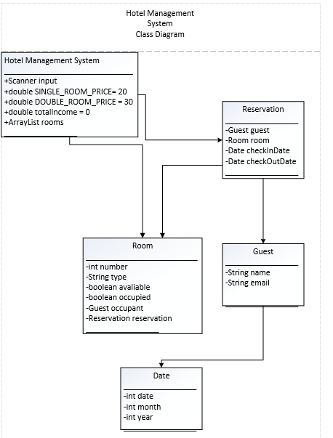
Classes
Hotel Management System
Date
Guest
Reservation
Room

Slide 3
Main class
Attributes:
+Scanner input
+double SINGLE_ROOM_PRICE= 20
+double DOUBLE_ROOM_PRICE = 30
+double totalIncome = 0
+ArrayList rooms
Functions:
main
parseDate
checkRoom
isValidEmail
containsNumbers
makeReservation
checkIn
checkOut
calculateTotalPrice (overloaded)
calculateNightDifference
searchGuest
reports
listAllRoomsReport
occupiedRoomsReport
availableRoomsReport
guestOccupancyReport
printOptions

Slide 4


Date class
Guest class
Attributes:
-int date
-int month
-int year
Functions:
differenceInDays
Date (constructor)
toString
isBefore
Attributes:
-String name
-String email
Functions:
getName
setName
getContact
setContact
toString

Slide 5
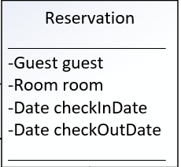
Reservation class
Attributes:
-Guest guest
-Room room
-Date checkInDate
-Date checkOutDate
Functions:
getGuest
setGuest
getRoom
setRoom
getCheckInDate
setCheckInDate
getCheckOutDate
setCheckOutDate

Slide 6
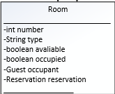
Room class
Attributes:
-int number
-String type
-boolean avaliable
-boolean occupied
-Guest occupant
-Reservation reservation-
Functions:
isAvailable
getReservation
setReservation
getRoomNumber
setRoomNumber
getType
setType
getAvailability
setAvailability
getOccupied
setOccupied
getOccupant
setOccupant
toString
setPrice

Slide 7
Thank You!

